Slide 1
Chicago CRIMES
Team Sherlock
Database Design and Implementation: PGPDM- UC-JIGSAW
Team Members: Ajay, Divya Teja, Adyan Prabhakaran, Anil Kumar

Slide 2
Introduction
INTRO
The following the database created with integration of crime data and public school data and police districts data
Chicago crime data is an extensive data set of crimes in Chicago, by city of Chicago with 22 columns and rows about 40,000, this dataset reflects reported incidents of crime (with the exception of murders where data exists for each victim) and described columns are ID, case number, date, block, primary type, FBI code, latitude, longitude, etc are listed
Public school data set gives us information about the school name, its category, community area, school id
Above are listed datasets are integrated with the Chicago police station data to implement action plans

Slide 3
Scope of project
INTRO
We can predict over the years how crime is changing, areas which are repeatedly affected by the crime, which areas of the city are evolved in a time span, how often a specific crime is happening in time span, how often the domestic violence is noticed in area or time span, and how particular crime is noticed in specific area, which type of crimes are more in specific areas, how many crimes are related to national threat, and which beats have high crime concentration ,which police sector have high crime concentration, how many crimes are happened with specific FBI code, and in how many crimes actually the victim was arrested, in how many crimes the victim was not arrested, by figuring the pattern of crime ,time span, area ,FBI code can we predict the happening of the next crime, we can design patrol table for police to a specific areas so that crimes happenings can be minimised, to which specific area of city, or to which specific timespan(date) where when high concentration of patrolling is required can assigned to the department.

Slide 4
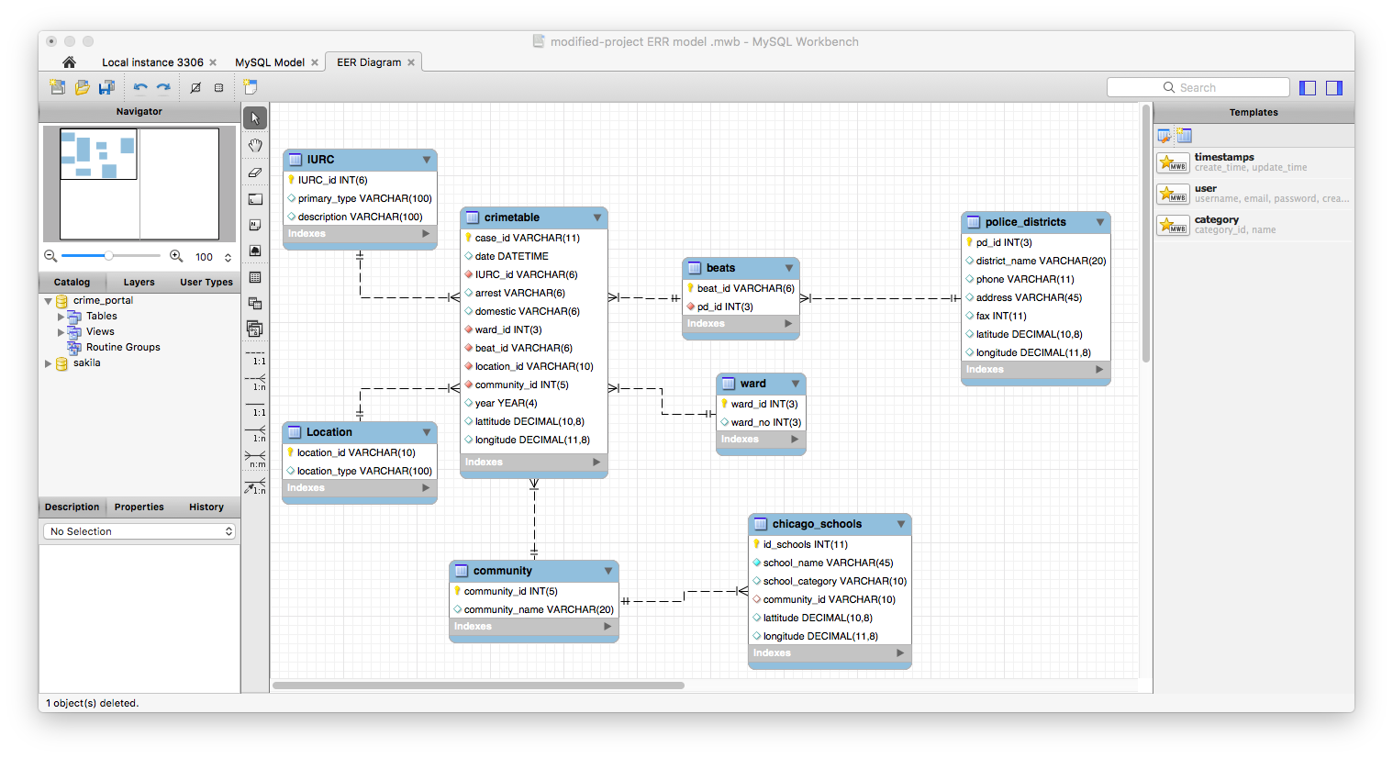
Entity Relationship Diagram
Design

Slide 5
Normalizing and uploading data
Build
Data Source: www.Kaggle.com/Chicagocrimes, data.cityofchicago.org
Data Preparation: Used Open refine and Removed many unnecessary fields from original tables
Data Cleanup: used Open Refine and Removed null values from wards and community.
Data Loading: Used a csv file import. Issues we encountered centered around file size and attributes sizes and formats defined in the MYSQL work bench.
Troubleshooting/lessons learned: Identifying the fields rejected fields and changed according to the table definition.

Slide 6
Extraction of DATA from MYsql
Build
Queries Executed as part of the Analysis.
Used SQL Intensively to join two or more tables and also used advanced SQL queries.
Used SQL to a create view of summarized data of schools vs police and crimes based on the community Id.
Used Group by and Order by and advanced SQL to extract month & day from DATE.

Slide 7
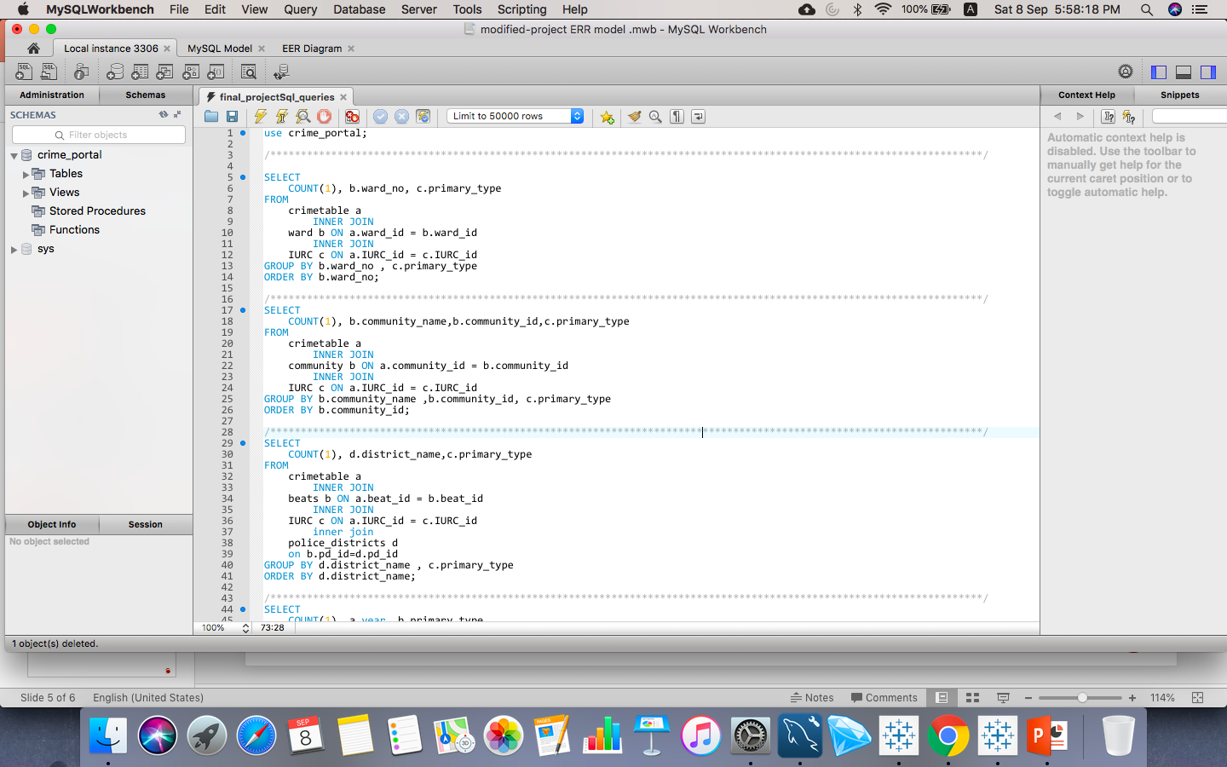
Build
Queries Executed as part of the Analysis.

Slide 8
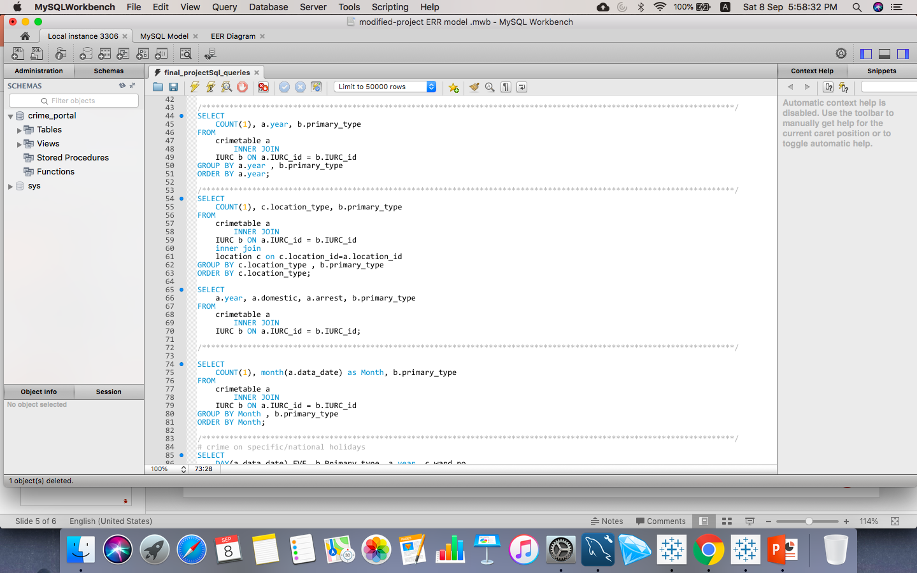
Build
Queries Executed as part of the Analysis.

Slide 9
Visualization Using TablEAu
Final
Dashboard 1
Used Wards, Police districts, Community, Year, Month, Location type as different attributes to visualize the crime types and there frequency.
Created Bar chats for each attribute vs frequency of the particular crimes.
Dashboard 2
Used Arrest and Domestic attributes to analyze trends starting from 2002 to 2016.
Used Treemaps to analyze the no of Crimes vs Years along with Arrest and Domestic.
Dashboard 3
Used data from the view created as part the analysis and created a dashboard to
Visualize No of Crimes near by The Schools and Police Districts near by and Provide the help line No.

Slide 10
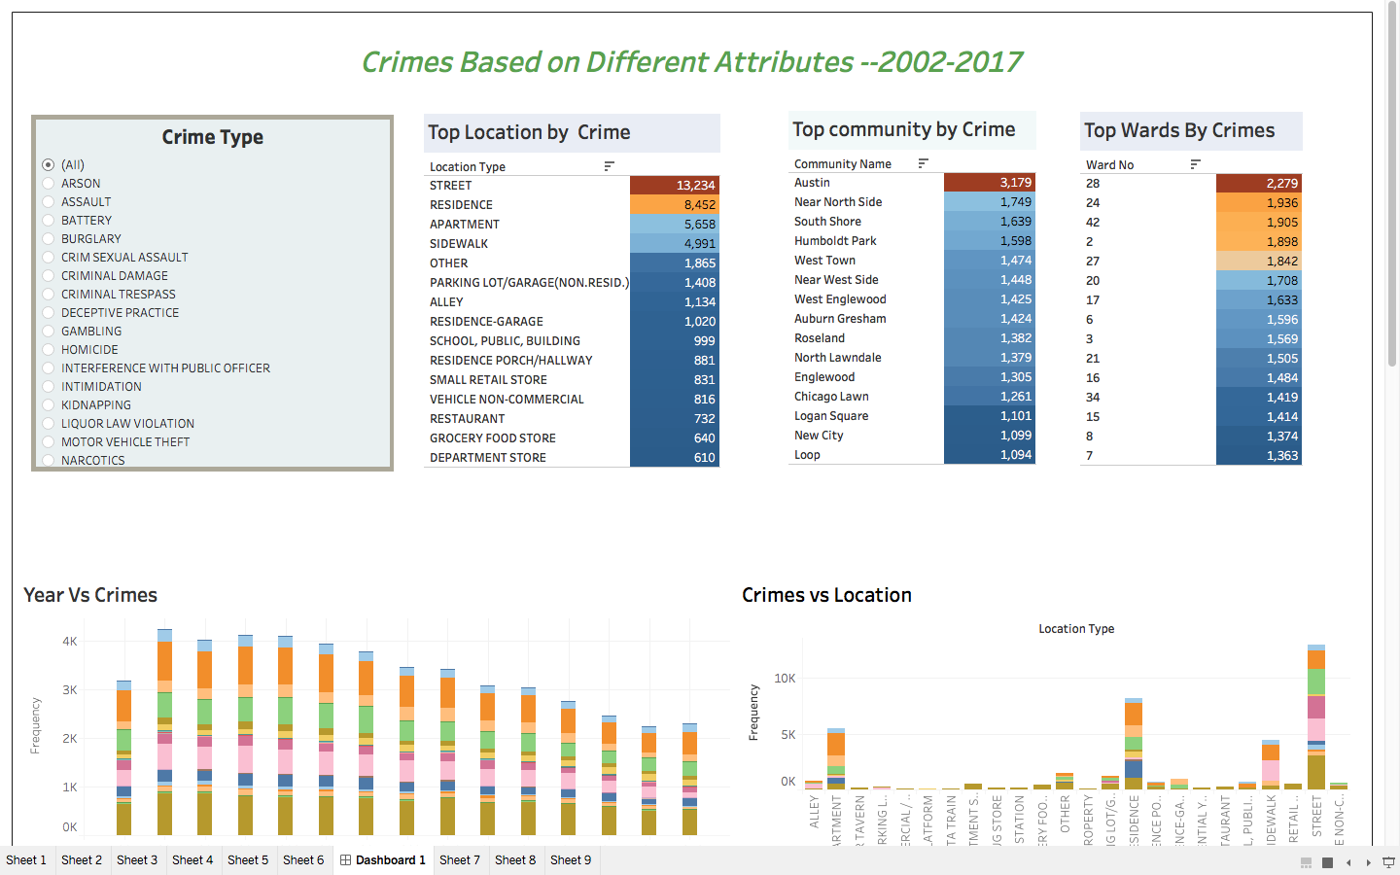
Dashboard 1

Slide 11
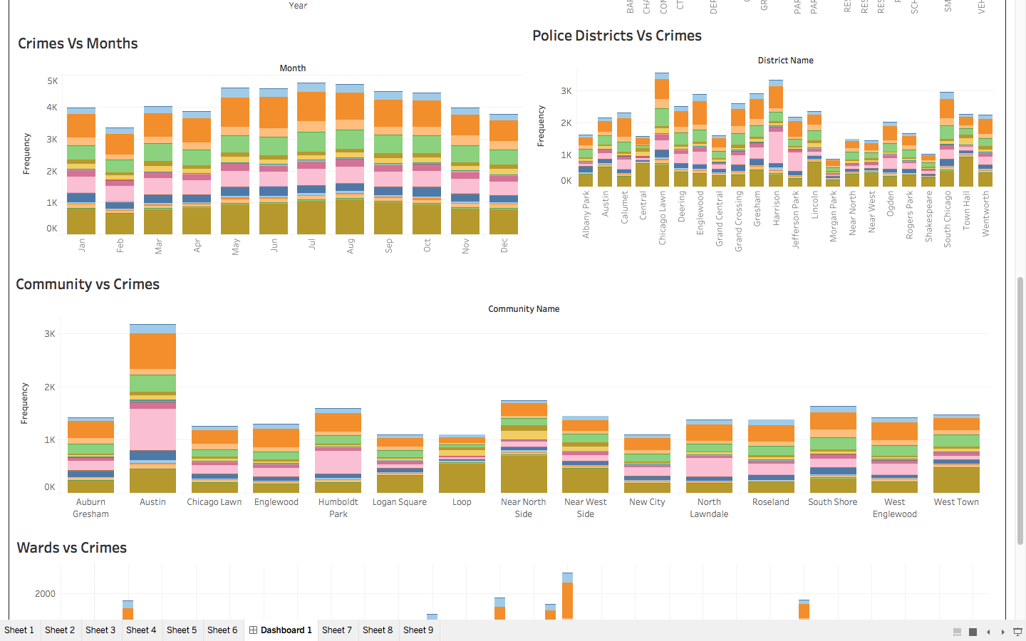
Dashboard 1

Slide 12
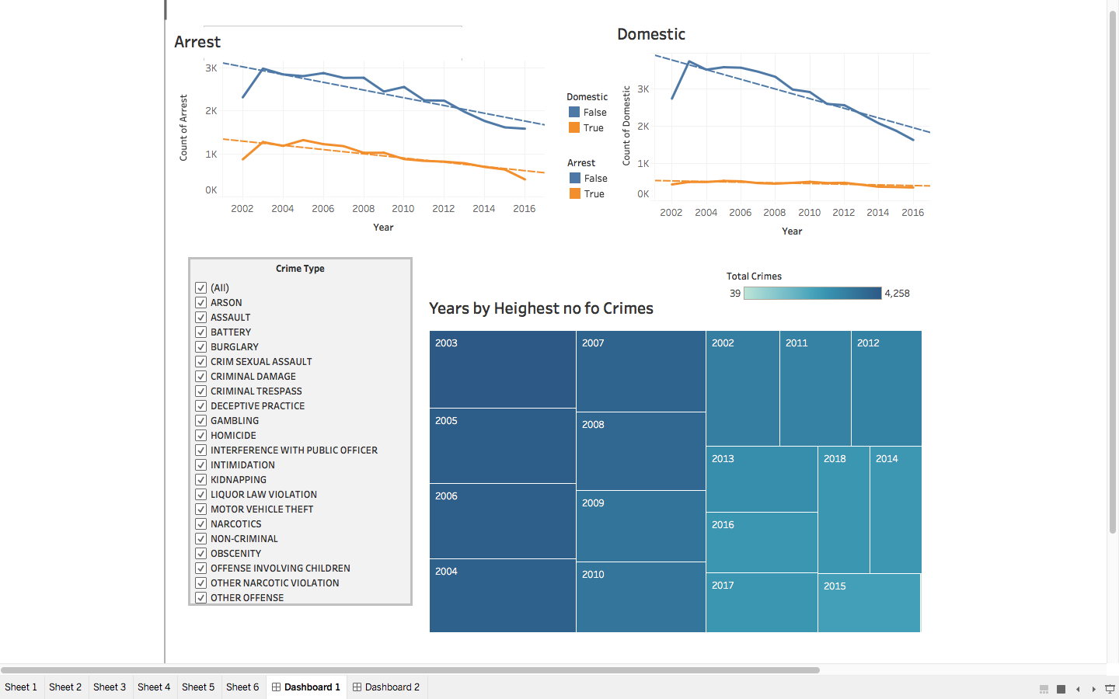
Dashboard 2

Slide 13
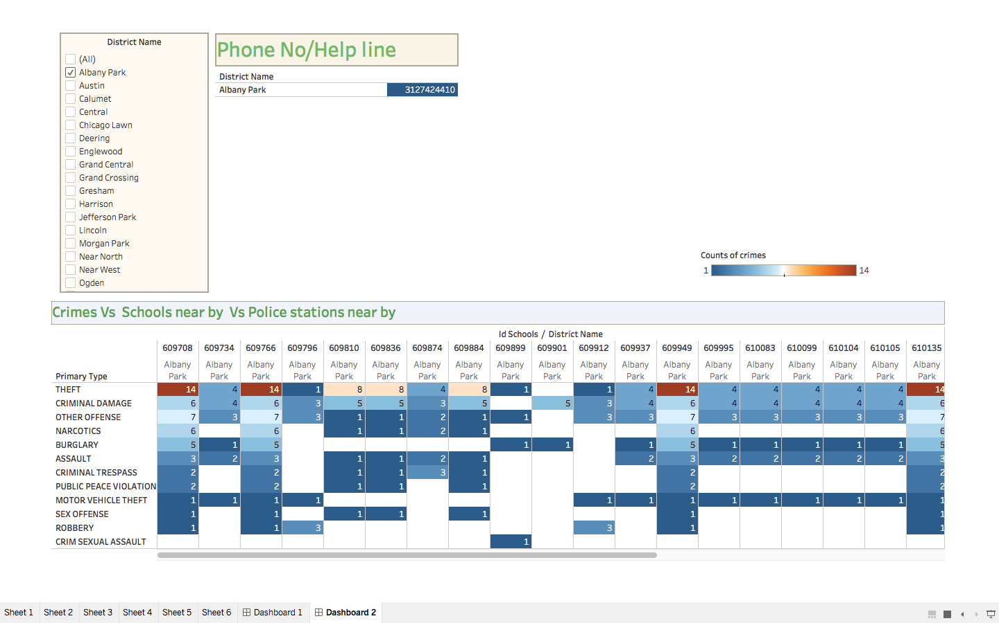
Dashboard 3

Slide 15
Lessons Learned
Data Wrangling ( manipulating raw data to achieve a final form. Parsing or filtering data, or the many steps required for data recognition )
Data Normalization process.
Getting into the right format across tables ( data Types )
Consistent naming across all tables
Better design structure before creating database/tables and uploading data.
Complex queries with calculations and creating aggregates
For updates the SQL_SAFE_UPDATES flag had to be set (SET SQL_SAFE_UPDATES = 1)
Basic Visualization using TABLEAU.
Get in touch With OPEN REFINE, MYSQL,TABLEAU.

